Slide 1
Labour Market Update markdown guide

Slide 2
Introduction
This slide deck introduces the LMU/CCLB Markdown.
Consists of four modular scripts. 01a downloads and prepares LMU data. 01b uses data and adds markdown text.
02 prepares entire CCLB output.
03 runs all the scripts in one go.
To run the markdown, follow the steps in the Quickstart Guide.
For more information on how to maintain the project, refer to the other slides.

Slide 3
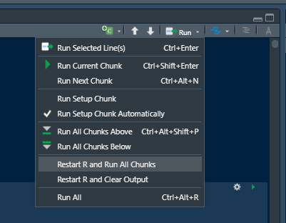
Quickstart Guide (I)
Make copies of the master scripts “* (m) YY-MM-DD”.
Insert current date and remove the (m) designation. Open files.
Perform the manual changes needed in 01a and 01b (see next slide).
Run 01a fully (e.g. using ‘Source’), then run 01b using ‘Run all chunks’ to produce tables and output within Rstudio.
Perform sense checks on the output and adjust.
Adjust chart axis ranges if needed and ensure they look reasonable compared to previous iterations
Run 03 to produce HTML documents in the folder (produces both LMU and CCLB).
Perform further checks
Ensure text makes sense (e.g. change “rose by 0%” to “no change”)
Upload the HTML to the Datastore and circulate by email.
Also remember to send an email to reps from London SRPs (see mailing lists here)

Slide 4
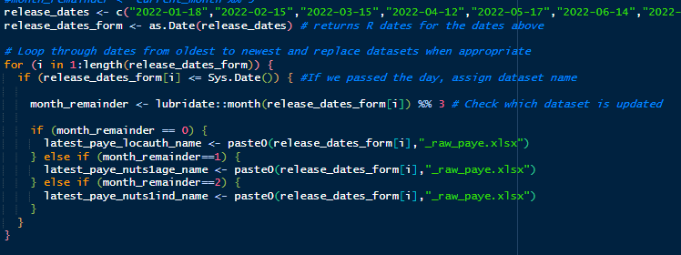
Quickstart Guide (II): manual changes
01a:
PAYE quarterly analyses: When running on LMU Day within RStudio, it is important to check that the correct datasets have been loaded for the quarterly updates.
01b:
PAYE quarterly analyses: Manually change the order of the analyses, so that the newest analysis comes first. This means selecting the entire relevant section (from the title to the HTML code following the graphical output) and moving it in front of the other two sections.
WFJ quarterly analysis: Unless new WFJ data has been released, the entire WFJ sections should be deleted from the script.
Change text where needed.
03: Remove “(m)” from script names.
Important: most manual changes are not done within the main (m) script, e.g. when manually replacing functions with hardcoded texts. However, permanent changes should be transferred to the (m) script as well.

Slide 5

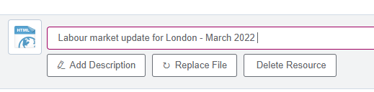
Quickstart Guide (III): uploading
This step requires authorisation to edit the Datastore.
Go to the Datastore page and log in.
Click “Add data”
Drag and drop the HTML document to the page and change the title to “Labour market update for London – MMM 20YY”.
Save the upload.
Move the R script and the final HTML document to the folder “Uploads”.

Slide 6
Claimant Count for London Boroughs (CCLB)
The CCLB is produced and maintained in conjunction with the LMU. It is also released on the same day.
Though the CCLB is somewhat simpler than the LMU in execution, it is still advisable to perform sense-checks on the charts and tables before publishing.

Slide 7
Project organisation (I)
The LMU can be found in the following folder:
Y:\Labour Market Update R Project\MARKDOWN
The folder structure and folder names should not be changed as paths within the script rely on the names being accurate.
However, the top-level MARKDOWN folder can be moved if necessary. The script should still be able to find the correct folders as long as the relative positions remain constant (see documentation on HERE package).
Note, the HERE package will look in your current working folder and work upwards looking for a folder with a .here file. Create an Rproj file in the copied MARKDOWN directory to anchor the HERE package.

Slide 8
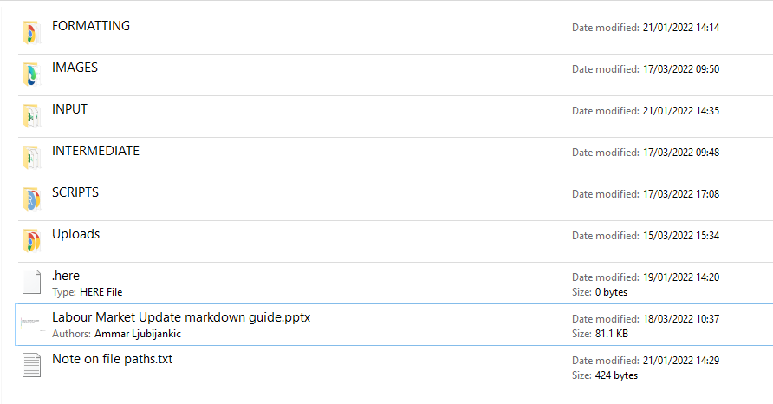
Project organisation (II): Folder structure
FORMATTING:
contains all files needed to format the markdown page. This includes the CSS codes and page images used.
IMAGES:
all the charts produced by the markdown saved as .png and .svg.
INPUT:
the external data files needed for mapping, e.g. geo codes and sub-regions.
INTERMEDIATE:
data files used by the markdown, whether downloaded automatically or manually.
SCRIPTS:
the scripts and HTML documents produced by the code.
Uploads:
to the Datastore and the scripts which produthe HTML documents uploaded ced them.
.here:
the file used by the script to identify the top-level folder.

Slide 9
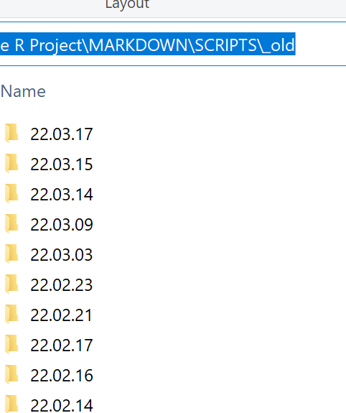
Version control
Version control is important for keeping track of changes in the script and output over time.
For this project, a new script should be saved for each day that changes are made:
Copy the current (master) script within the SCRIPTS folder and rename with today’s date.
Move the previous script and its output (if any) to a new folder within SCRIPTS/_old, also with today’s date in the format YY.MM.DD.
This procedure should also be used for other files which are changed manually, e.g. within the FORMATTING and INPUT folder.
Files within IMAGES and INTERMEDIATE do not need to be backed up.

